Slide 1

Website Proposal
Presented by:
Camperina & partner

Slide 2
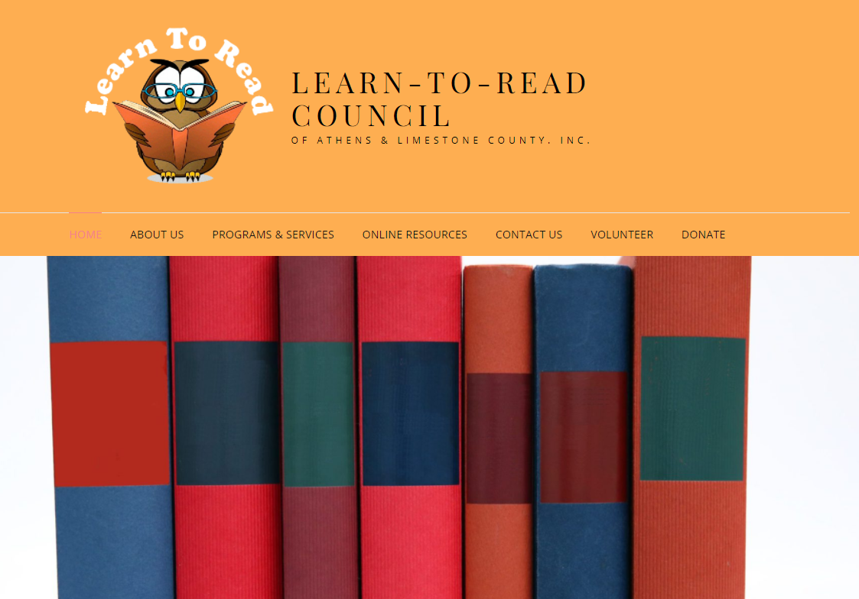
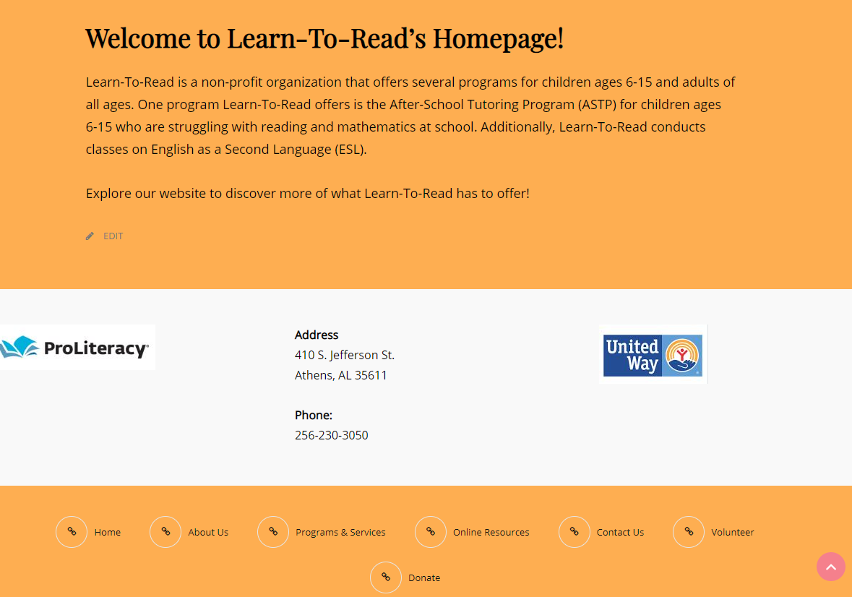
Home
Kept the owl logo
Removed the “:” from the title
Updated the address
Removed CFC & added ProLiteracy

Slide 3
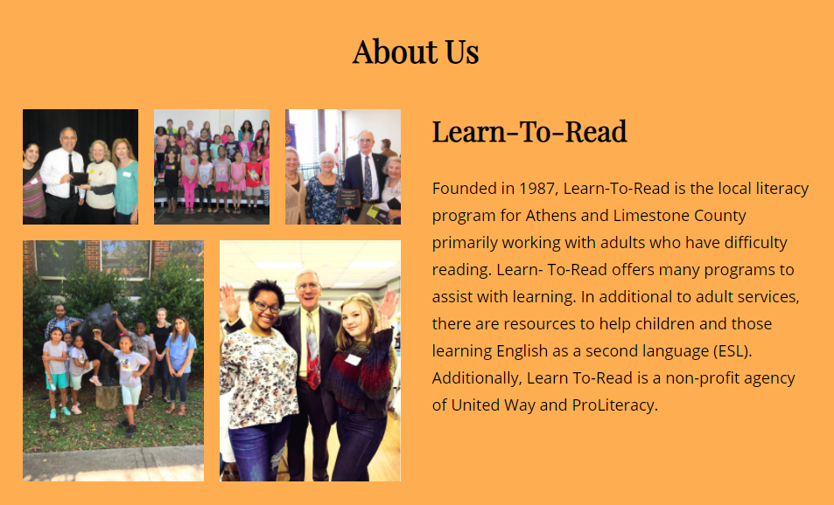
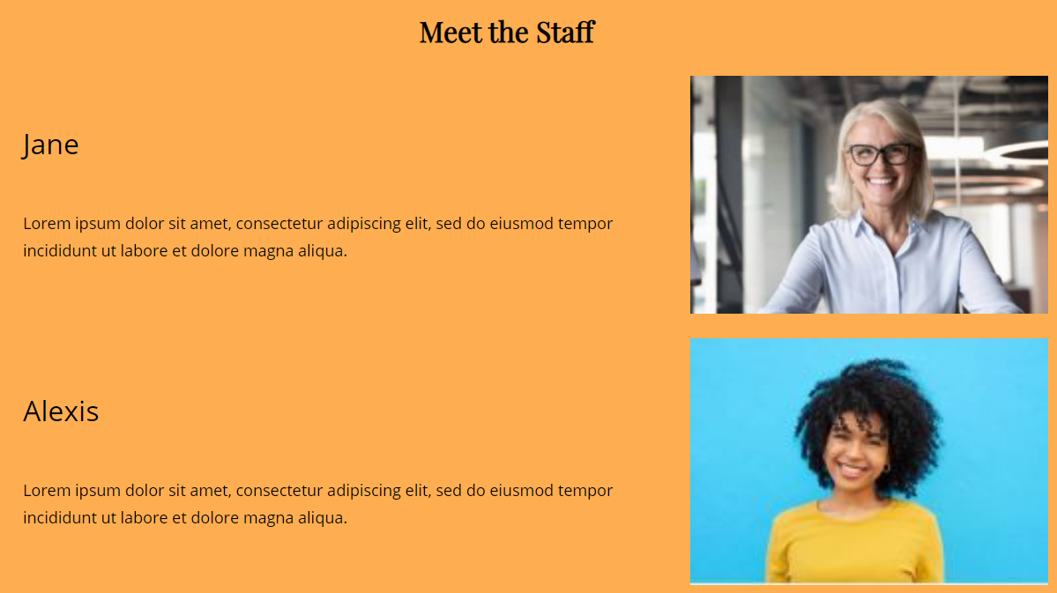
About Us
Updated pictures
Added “Meet the Staff” section

Slide 4
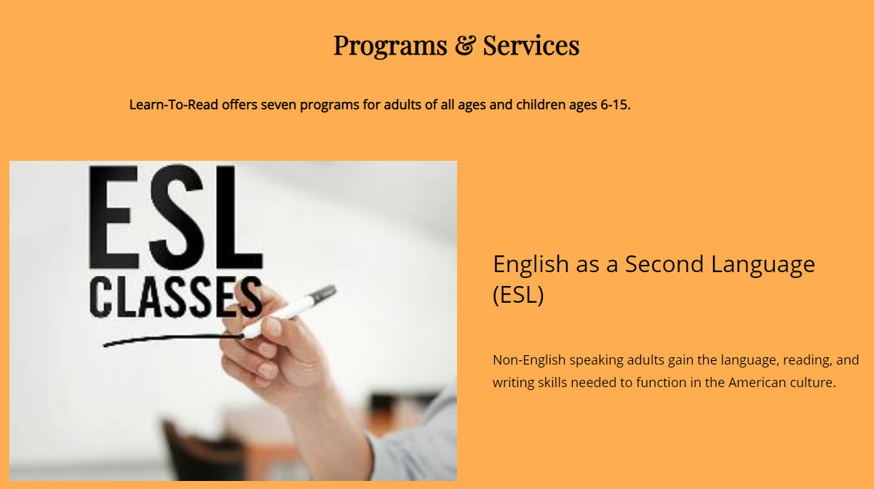
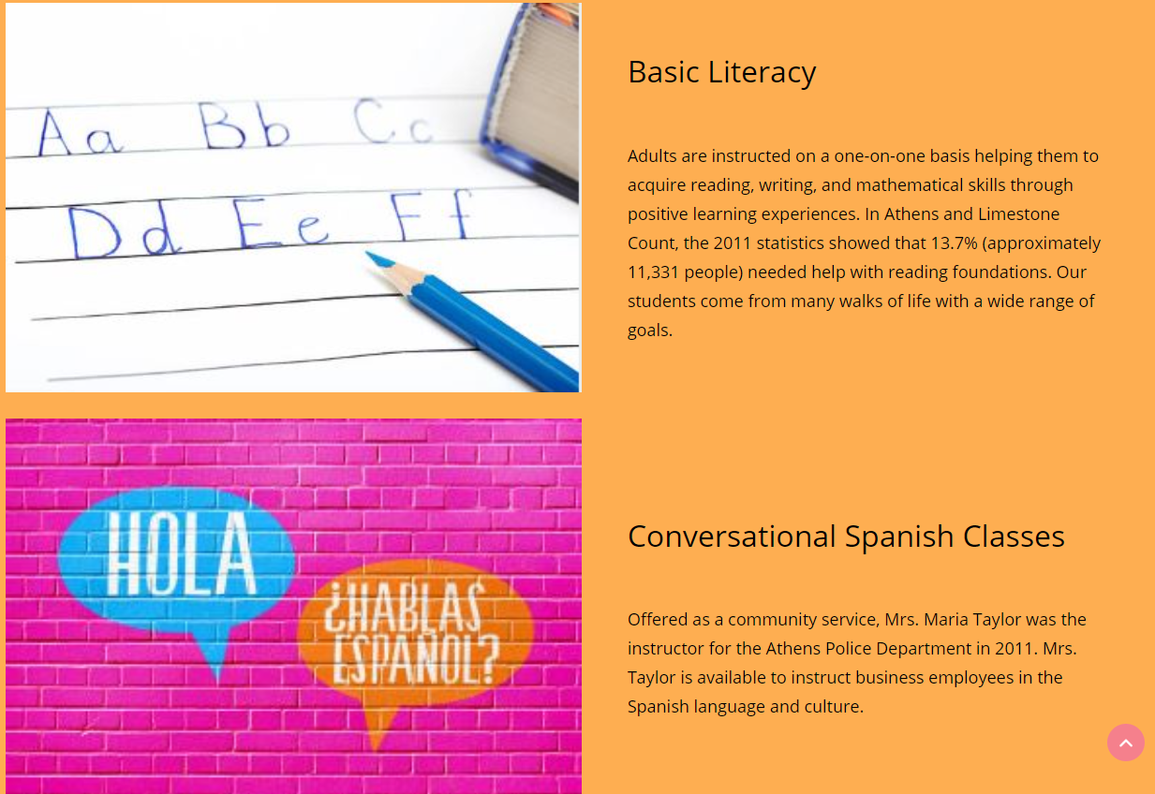
Programs & Services
Changed layout
New images

Slide 5

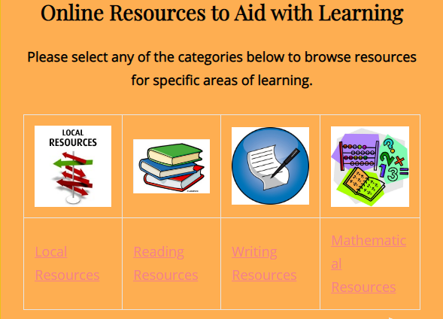
Online Resources
Category table has links to each section in the page.
Each section has a link to the category table at the top of the page.
Image icons have links to the respective websites
Removed CFC and added ProLiteracy.

Slide 6

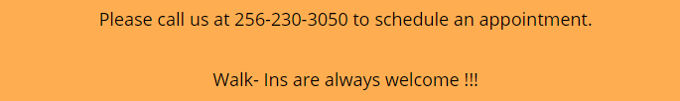
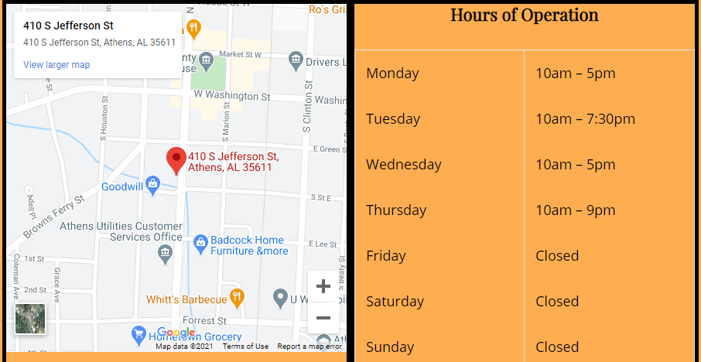
Contact Us
Embedded google map.
Updated hours of operation.
Has information about scheduling an appointment.
Included a form to reach out to the organization.

Slide 7


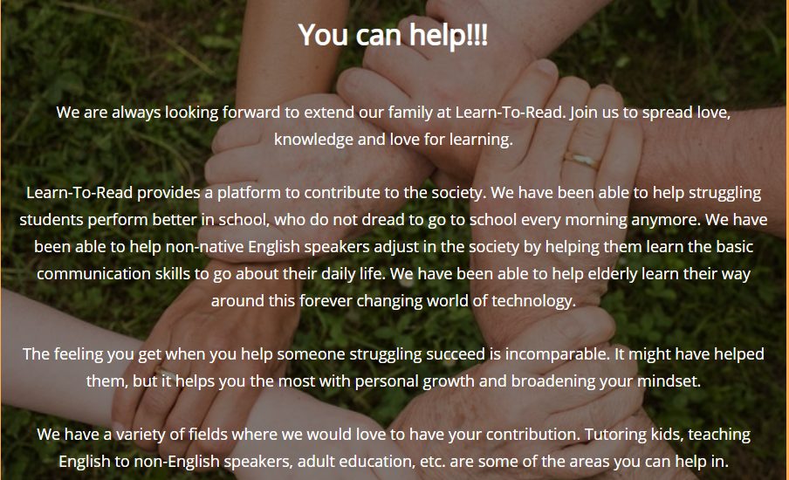
Volunteer
Included information about area where one can volunteer.
Gave a little description about Learn-To-Read’s volunteering works.
Added encouraging words for volunteers.
Included a form to apply for volunteering.
Removed the closing days from the options for volunteering.

Slide 8


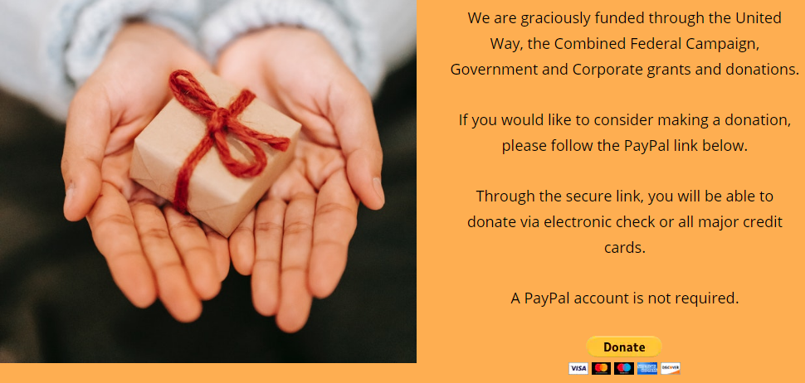
Donate
Included a suitable picture to make the page look more inviting.
Added a little information about how to donate.
Added the icon for donate button.

Slide 9
Thank you
for your time!

